Slide 1
Computer Architecture
Lecture 01

Slide 2
Reference Books
Computer Organization and Architecture: Designing for Performance- William Stallings (8th Edition)
Any later edition is fine

Slide 3
Definitions
Computer architecture refers to those attributes of a system visible to a programmer or
Those attributes that have a direct impact on the logical execution of a program
Computer organization refers to the operational units and their interconnections that realize the architectural specifications
Example of architectural attributes: Instruction set, the number of bits used to represent various data types (e.g., numbers, characters), I/O mechanisms, and techniques for addressing memory
Example of organizational attributes: Hardware details transparent to the programmer, such as control signals; interfaces between the computer and peripherals; and the memory technology used

Slide 4
Definitions
For example, it is an architectural design issue whether a computer will have a multiply instruction
On the other hand, it is an organizational issue whether that instruction will be implemented by a special multiply unit or by a mechanism that makes repeated use of the add unit of the system

Slide 5
STRUCTURE AND FUNCTION
A computer is a complex system
The hierarchical nature of complex systems is essential to both their design and their description
The designer need only deal with a particular level of the system at a time
At each level, the system consists of a set of components and their interrelationships and the designer is concerned with associated structure and function:
Structure: The way in which the components are interrelated
Function: The operation of each individual component as part of the structure

Slide 6
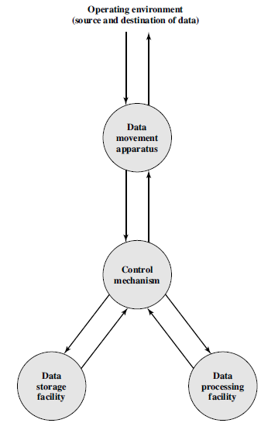
Functional View of a Computer

Slide 7
Functional units
In general terms, there are only four functional units:
Data processing: The computer must be able to process data
The data may take a wide variety of forms, and the range of processing requirements is broad
Data storage: It is also essential that a computer store data
If the computer is processing data on the fly (i.e., data come in and get processed, and the results go out immediately), the computer must temporarily store at least those pieces of data that are being worked on at any given moment
Thus, there is at least a short-term data storage function
Equally important, the computer performs a long-term data storage function also
Files of data are stored on the computer for subsequent retrieval and update

Slide 8
Functional units
Data movement: The computer must be able to move data between itself and the outside world
The computer’s operating environment consists of devices that serve as either sources or destinations of data
When data are received from or delivered to a device that is directly connected to the computer, the process is known as input–output (I/O), and the device is referred to as a peripheral
When data are moved over longer distances, to or from a remote device, the process is known as data communications
Control: There must be control of these three functions
This control is exercised by the individual(s) who provides the computer with instructions
Within the computer, a control unit manages the computer’s resources and orchestrates the performance of its functional parts in response to those instructions

Slide 9
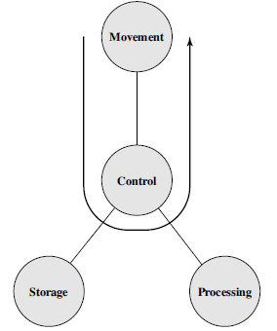
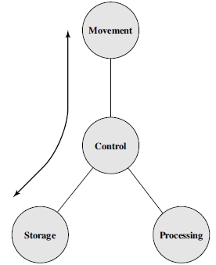
Possible Operations
The computer can function as a data movement device (Figure 1), simply transferring data from one peripheral or communications line to another
It can also function as a data storage device (Figure 2), with data transferred from the external environment to computer storage (read) and vice versa (write)

Slide 10
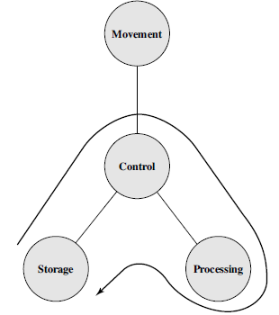
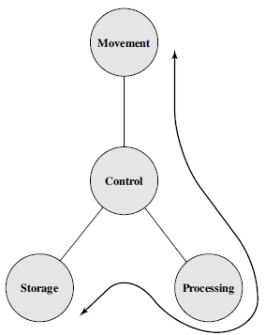
Possible Operations
The final two diagrams show operations involving data processing, on data either in storage (Figure 3) or en route between storage and the external environment (Figure 4)

Slide 11
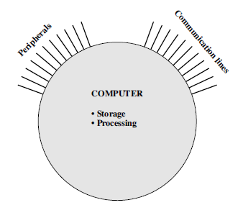
Structural Units/Components
This is the simplest possible depiction of a computer
The computer interacts in some fashion with its external environment
In general, all of its linkages to the external environment can be classified as peripheral devices or communication lines

Slide 12
Structural Units/Components
There are four main structural components:
Central processing unit (CPU): Controls the operation of the computer and performs its data processing functions
Often simply referred to as processor
Main memory: Stores data
I/O: Moves data between the computer and its external environment
System interconnection: Some mechanism that provides for communication among CPU, main memory, and I/O
A common example of system interconnection is by means of a system bus, consisting of a number of conducting wires to which all the other components attach

Slide 13
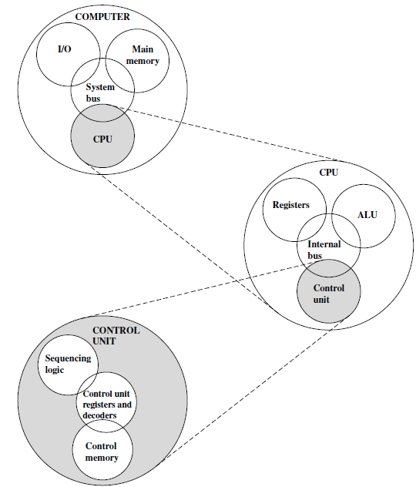
Top-Level Structure

Slide 14
Evolution of Computers
First Generation: Vacuum Tubes
ENIAC The ENIAC (Electronic Numerical Integrator And Computer)
Designed and constructed at the University of Pennsylvania
World’s first general purpose electronic digital computer
Second Generation: Transistors
The first major change in the electronic computer came with the replacement of the vacuum tube by the transistor
The transistor was invented at Bell Labs in 1947
The transistor is smaller, cheaper, and dissipates less heat than a vacuum tube but can be used in the same way as a vacuum tube to construct computers
Unlike the vacuum tube, which requires wires, metal plates, a glass capsule, and a vacuum, the transistor is a solid-state device, made from silicon

Slide 15
Evolution of Computers
Third Generation and forth: Integrated Circuits
A single, self-contained transistor is called a discrete component
Throughout the 1950s and early 1960s, electronic equipment was composed largely of discrete components—transistors, resistors, capacitors, and so on
Discrete components were manufactured separately, packaged in their own containers, and soldered or wired together onto masonite-like circuit boards, which were then installed in computers, oscilloscopes, and other electronic equipment
Whenever an electronic device called for a transistor, a little tube of metal containing a pinhead-sized piece of silicon had to be soldered to a circuit board
The entire manufacturing process, from transistor to circuit board, was expensive and cumbersome
In 1958 came the achievement that revolutionized electronics and started the era of microelectronics: the invention of the integrated circuit

Slide 16
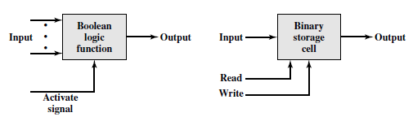
Evolution of Computers
Microelectronics means, literally, “small electronics”
The basic elements of a digital computer: only two fundamental types of components are required
Gates and memory cells
A gate is a device that implements a simple Boolean or logical function, such as IF A AND B ARE TRUE THEN C IS TRUE (AND gate)
Such devices are called gates because they control data flow in much the same way that canal gates do
The memory cell is a device that can store one bit of data; that is, the device can be in one of two stable states at any time
By interconnecting large numbers of these fundamental devices, we can construct a computer

Slide 17
Evolution of Computers
Four basic functions could be related to these two components as follows:
Data storage: Provided by memory cells
Data processing: Provided by gates
Data movement: The paths among components are used to move data from memory to memory and from memory through gates to memory
Control: The paths among components can carry control signals
For example, a gate will have one or two data inputs plus a control signal input that activates the gate
When the control signal is ON, the gate performs its function on the data inputs and produces a data output
Similarly, the memory cell will store the bit that is on its input lead when the WRITE control signal is ON
These components could be made as integrated circuits
The integrated circuit exploits the fact that such components as transistors, resistors, and conductors can be fabricated from a semiconductor such as silicon (Si)

Slide 18
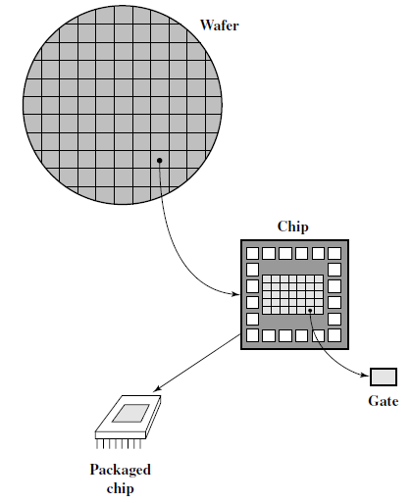
Relationship Among Wafer, Chip, and Gate

Slide 19
Fabrication of Integrated Circuits
A thin wafer of silicon is divided into a matrix of small areas, each a few millimeters square or less
The identical circuit pattern is fabricated in each area, and the wafer is broken up into chips
Each chip consists of many gates and/or memory cells plus a number of input and output attachment points
This chip is then packaged in housing that protects it and provides pins for attachment to devices beyond the chip
A number of these packages can then be interconnected on a printed circuit board to produce larger and more complex circuits

Slide 20
Fabrication of Integrated Circuits
Initially, only a few gates or memory cells could be reliably manufactured and packaged together
These early integrated circuits are referred to as small-scale integration (SSI)
As time went on, it became possible to pack more and more components on the same chip
And so comes the terms- LSI, MSI, VLSI and ULSI

Slide 21
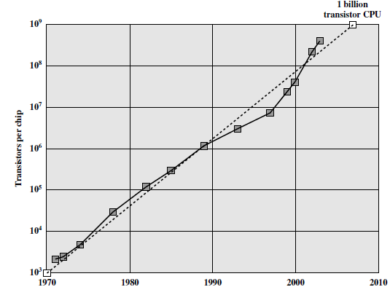
Moore’s law

Slide 22
Moore’s law
The consequences of Moore’s law are profound:
The cost of a chip has remained virtually unchanged during this period of rapid growth in density
This means that the cost of computer logic and memory circuitry has fallen at a dramatic rate
Because logic and memory elements are placed closer together on more densely packed chips, the electrical path length is shortened, increasing operating speed
The computer becomes smaller, making it more convenient to place in a variety of environments
There is a reduction in power and cooling requirements
The interconnections on the integrated circuit are much more reliable than solder connections
With more circuitry on each chip, there are fewer inter-chip connections

Slide 23
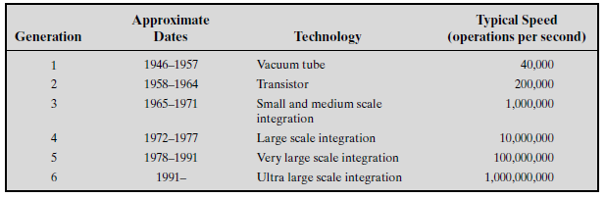
Comparison – Among Generations

